Slide 1
Strategic Partnerships
Students making an enterprise in real time SM@RT
2014‐1‐FI01‐KA201‐000894_3
2014/2017
ISISS “Terra di Lavoro” CASERTA
"The European Commission support for the production of this publication does not constitute an endorsement of the contents which reflects the views only of the authors, and the Commission cannot be held responsi­ble for any use which may be made of the information contained therein."

Slide 2
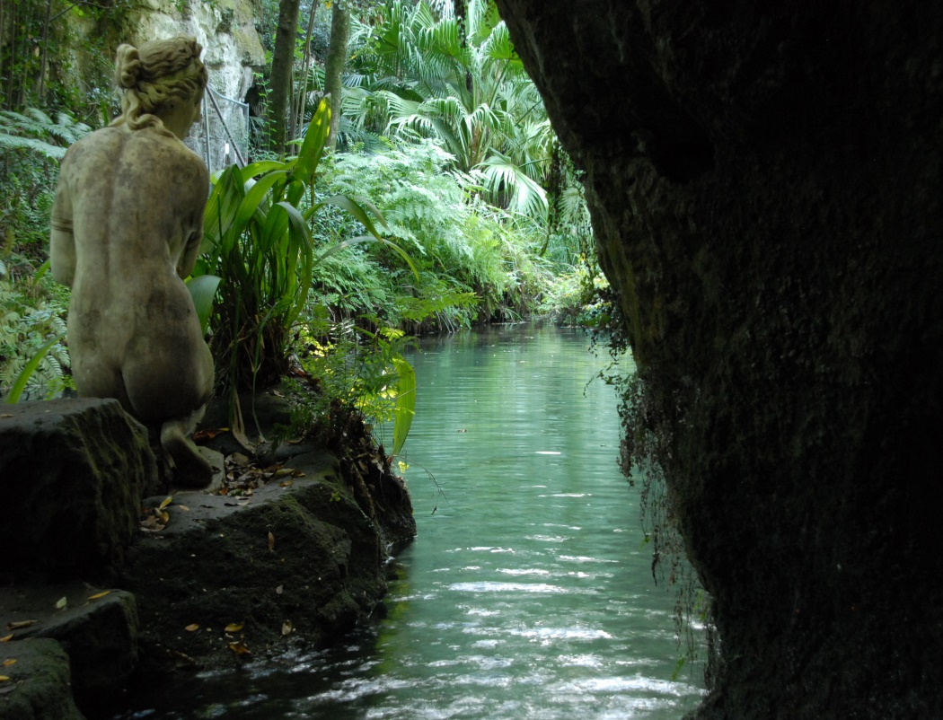
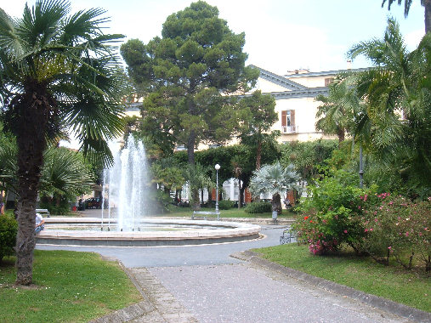
A TRAVEL AGENCY in Caserta - ITALY

Slide 3
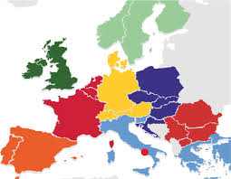
OUR AGENCY
Tuzimek Estera
FLY-AWAY
SRL
Travel agency DIRECTOR
Narducci Giulia
Vernillo Antonio
Makar Oksana
SALES AND CUSTOMER CARE
DEPARTMENT
ADVERTISEMENT
OPERATOR
PERSONNELL
DEPARTMENT

Slide 4
Travel agents provide a variety of services to clients:
purchasing airline tickets,
making hotel and resort reservations,
creating itineraries for tour or cruise packages and
providing information about specific destinations.
To start a travel agent business, we need
- a working knowledge of travel agent software,
- customer service experience
- experience in travelling to different parts of the world.
SKILLS

Slide 5
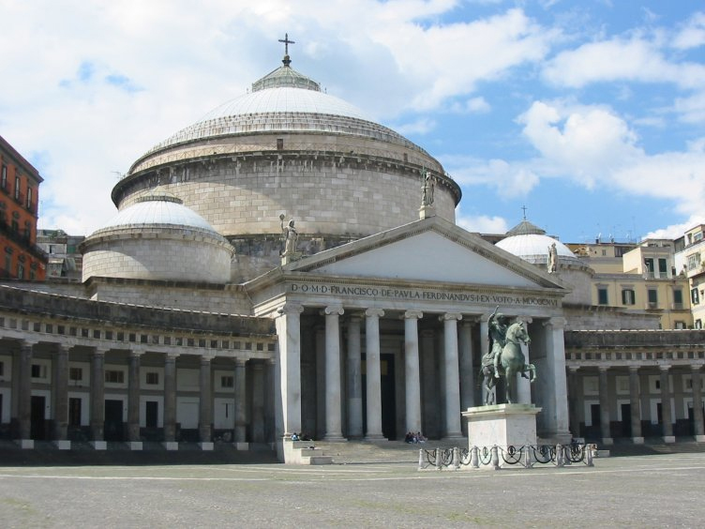
START –UP COSTS
Start-up costs are usually minimal because we need only:
phone, computer and software;
IATA number, which is needed to book flights with airlines;
Internet service and marketing materials needed to run the business ;
Lease a space for our travel agency( but we can work from home too ).
A client list may also be provided.

Slide 6
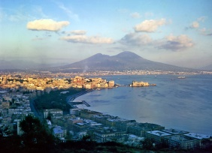
OUR STEPS
Get funding:
As we are a 16-18 age group, we can get funding applying for a grant provided by Imprenditorialità Giovanile [IG] that concedes grants and free financial subsidies to youth entrepreneurs (in the age group of 18 to 35) to start their own ventures and to cover up to 60% of capital requirement.
We had to prepare an analytic business plan.

Slide 7
It is the blueprint for your tourism business, and should include the following sections
Executive summary.
Describe your business's purpose, name, location, personnel needs, tourism business management staff, market sector, competition, marketing plan and financial projections.
Tourism business summary.
This should detail how the business ownership will be distributed and the start up requirements (funding, assets and location).

Slide 8
OUR STEPS
Legal and administrative practices:
As we are a 16-18 age group, we can get funding applying for a grant provided by Imprenditorialità Giovanile [IG] that concedes grants and free financial subsidies to youth entrepreneurs (in the age group of 18 to 35) to start their own ventures and to cover up to 60% of capital requirement.
We constitued our company; we chose a Limited-liability company;
the company was assigned an Italian tax number, the VAT number (Partita IVA).
A notary drew up a corporate deed;
we registered our business with a simple operation that takes place in a fully electronic procedure called "ComUnica".

Slide 9
OUR OFFICE
We contacted local commercial real estate agents to find an available retail space: we chose a little space in a famous trade center with a wide parking, called Campania center.
The space is however large enough to meet with clients while housing computer equipment , furniture and marketing materials.

Slide 10
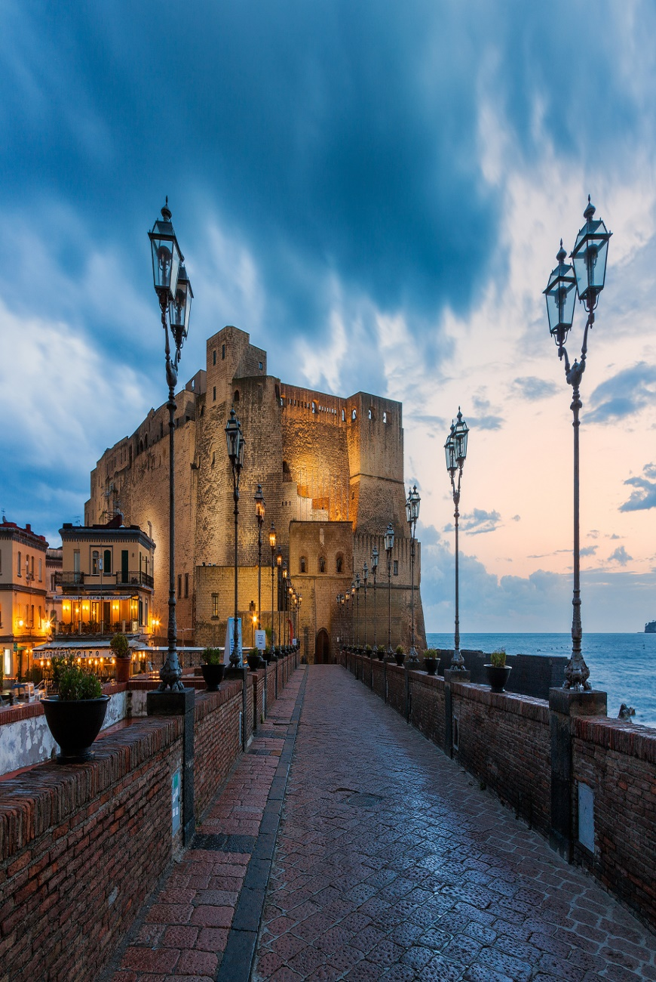
SERVICES OFFERED
Our company offers:
transportation arrangements (air, train, boat, car), hotel and resort reservations, cruises and specialized tour packages such as eco-tours or city-based tours.
We are mainly specialized in family travel, senior travel, corporate travel or academic travel to set our business apart from other travel agencies.

Slide 11
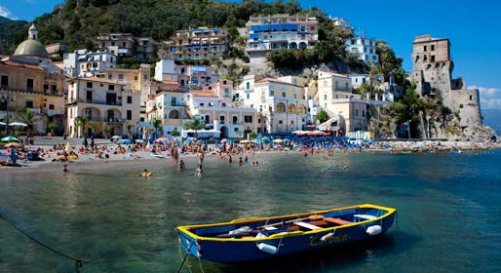
….. SERVICES
Purchase general liability or home-based business insurance to protect your business in the event of a lawsuit or settlement.
Worker's compensation insurance may be necessary if hiring employees.
This insurance helps pay the costs incurred through an accident or injury at the workplace.

Slide 12
Create marketing materials, such as brochures, business cards and flyers to promote your travel agency.
Build a client list that includes email addresses, travel preferences, past travel destinations. Send email updates of travel specials, events or other information of interest to clients each business quarter to encourage sales.

Slide 13
Create marketing materials, such as brochures, business cards and flyers to promote your travel agency.
Build a client list that includes email addresses, travel preferences, past travel destinations. Send email updates of travel specials, events or other information of interest to clients each business quarter to encourage sales.

Slide 15
Products and/or services.
You need to outline the products and/or services your business will be providing for tourists.
Analysis of the market
Provide information about your target market and your competition.
Tourism business strategy.
Describe how you plan on running your business, marketing your business and pricing your product or service.
Financial summary
State your projections for your business's expenses and income

Slide 16
HOPING TO START A LONG-LASTING MUTUAL COOPERATION,
WE THANK
ERASMUS+ AND THE NATIONAL AGENCIES FOR GIVING US THIS OPPORTUNITY
AND …
ALL OF YOU FOR YOUR PRECIOUS ATTENTION!!!

