Slide 1

A THREE - DAY VISIT TO …
Posavje
Travel Agency Zvezda

Slide 2
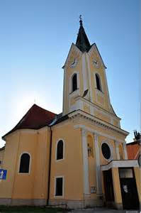
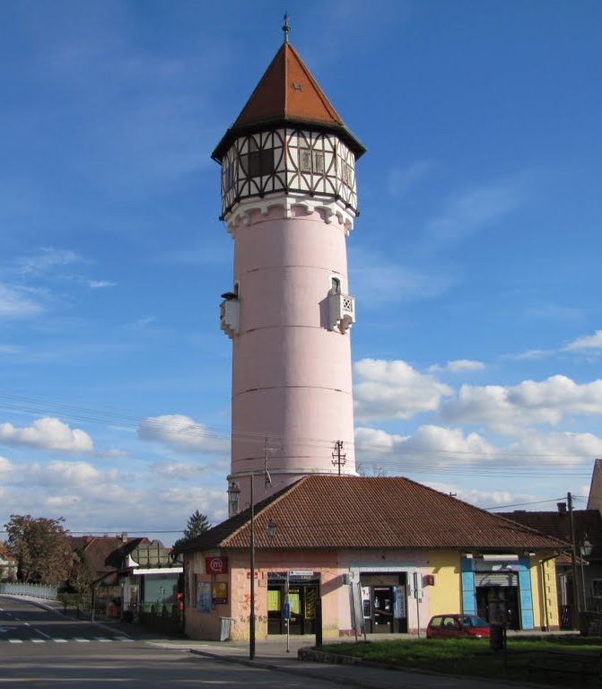
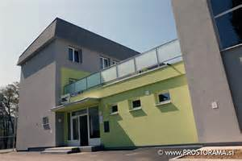
Day 1
Arrival at the Youth Hostel Mc Brežice
Sightseeing in the town of Brežice
Visit of the castle of Brežice
Visit of the church of Saint Lovrenc and water tower

Slide 3
11h – 12 h | Arrival at the hostel
12.30 h | Lunch at the inn Santa Lucija
15 h | Meeting at the youth hostel Mc Brežice Sightseeing in Brežice Visit of the castle Visit of the church of st. Lovrenc and water tower
17 h – 18.30 h | Free time
18. 30 h 20.00 … | Dinner at the hostel - Welcome party at the hostel („Get to know people“)

Slide 4
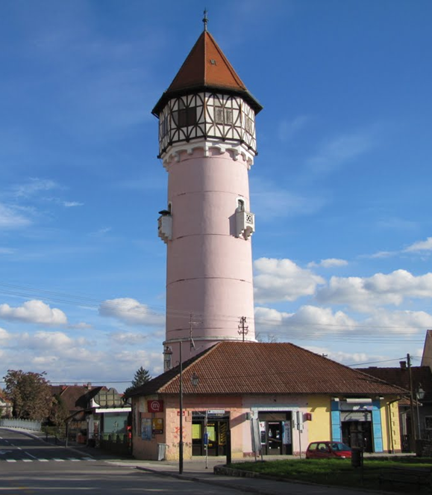
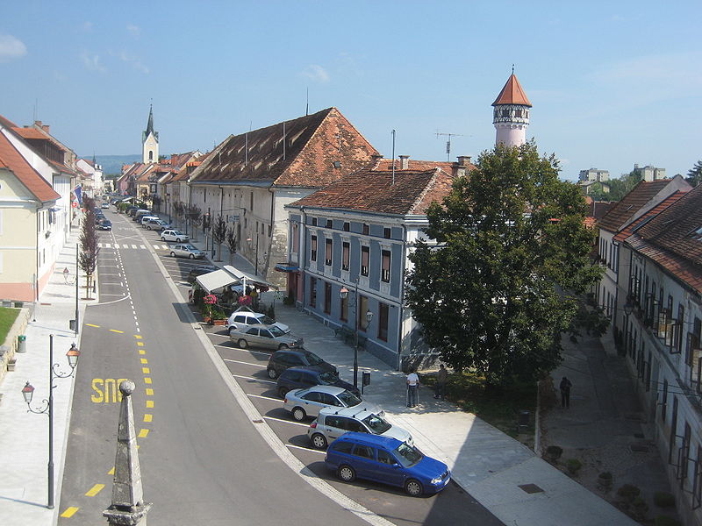
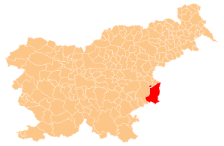
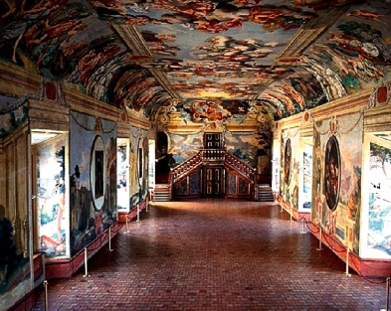
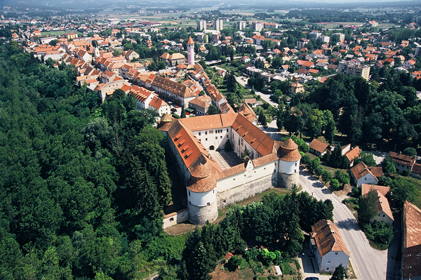

Water tower
city
castle (the Knights‘ Hall)

Slide 5




Welcome party in the evening
Activities:
get to know people and …
learn about other conutries…
dance and…
have some snacks
play funny party games and …
BECOME FRIENDS

Slide 6

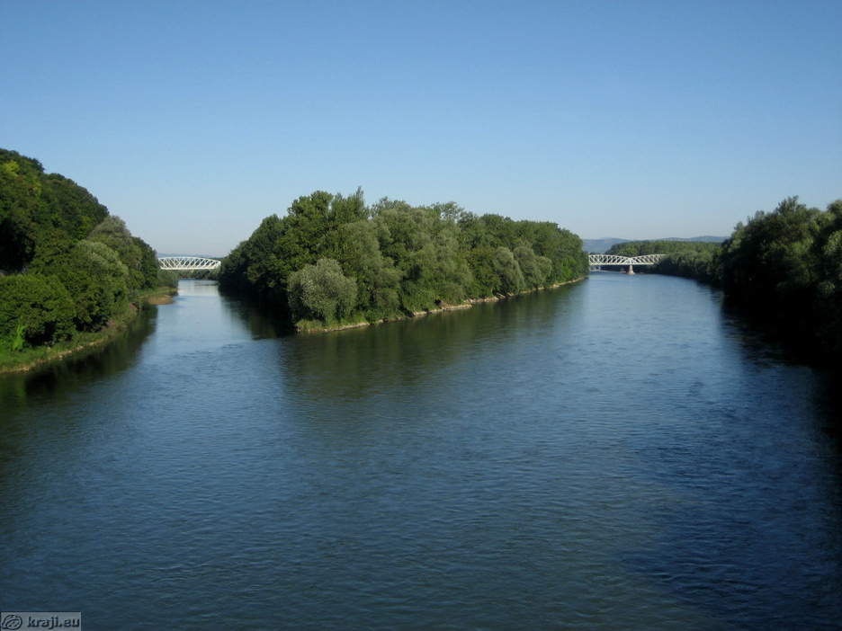

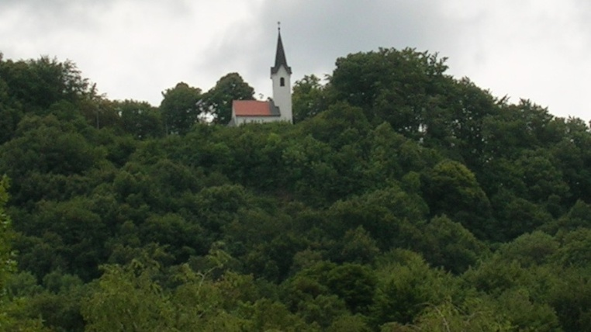

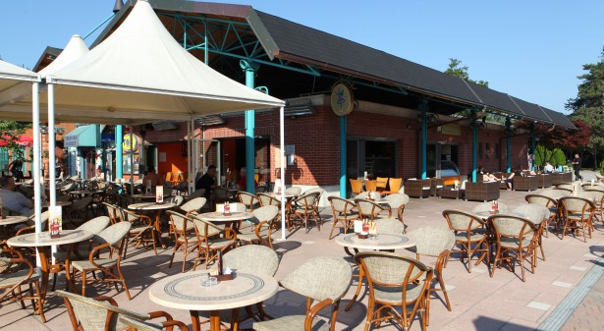

Day 2
Visit of the confluence
of the rivers Krka and Sava
Tracking on Šentvid hill
Visit of the Spa Terme Čatež

Slide 7
9.00 h | Breakfast at the hostel
10.00 h | Visit of the confluence of the two rivers Sava and Krka
11.00 h | Tracking on Šentvid hill - Free time
14.00 h | Lunch at the inn Santa Lucija
15.30 h | Visit of the Spa Terme Čatež
20.00 h | Dinner at the Rafters pub

Slide 8
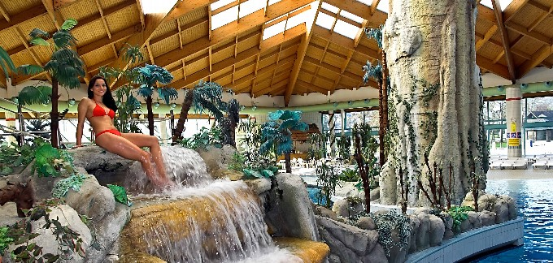
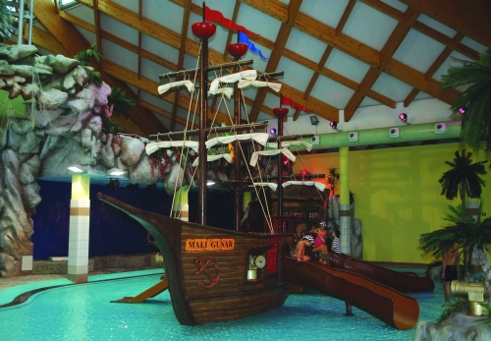
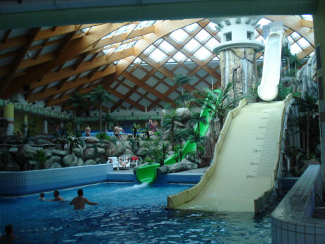
Some impressions from the Spa
Terme Čatež

Slide 9
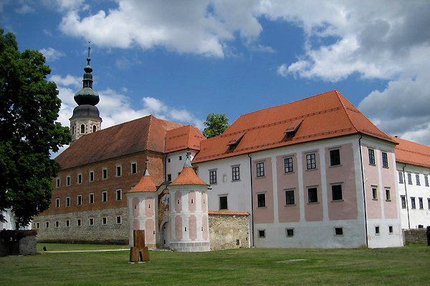
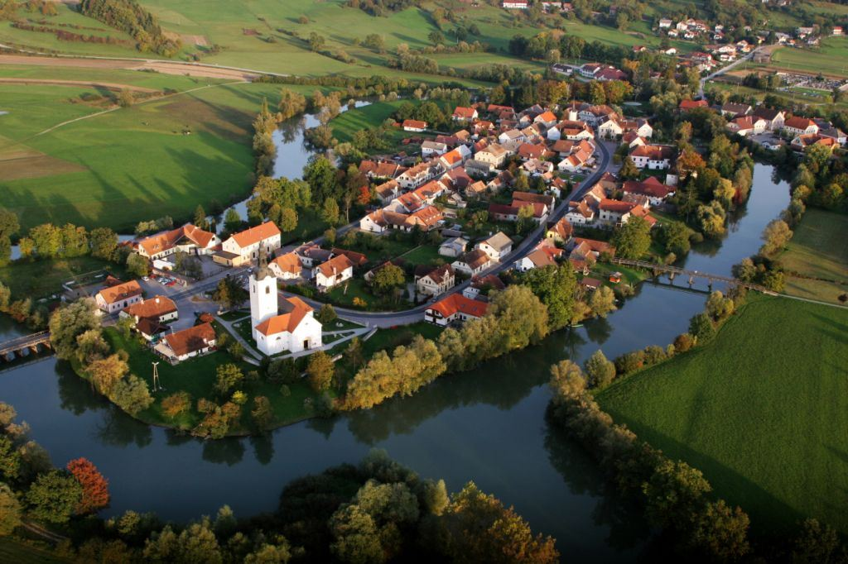
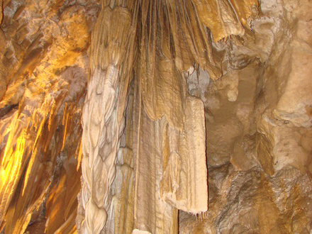
Day 3
Visit of Kostanjevica –
the smallest town in Slovenia,
monastery and the
Karstic cave.

Slide 10
9.00 h | Breakfast at the hostel
10.00 h 11.00 h 12.30 h | Meeting at the hostel Visit of Kostanjevica visit of monastery visit of the Karstic cave
13.30 h | Lunch in Kostanjevica Free time
15.00 h | Boating on the river Krka and bathing
19.00 h | Arrival in Brežice
19.30 | Dinner at the inn Santa Lucija
20 h | Farewell party: Sharing impressions (some presentations of the nicest adventures) entertainment

Slide 11
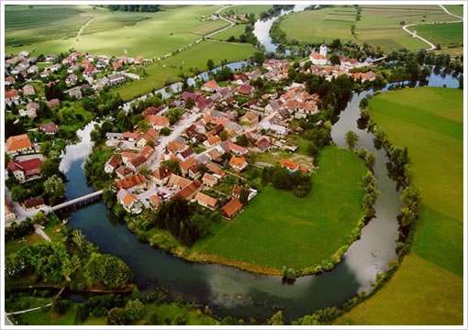
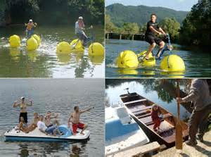
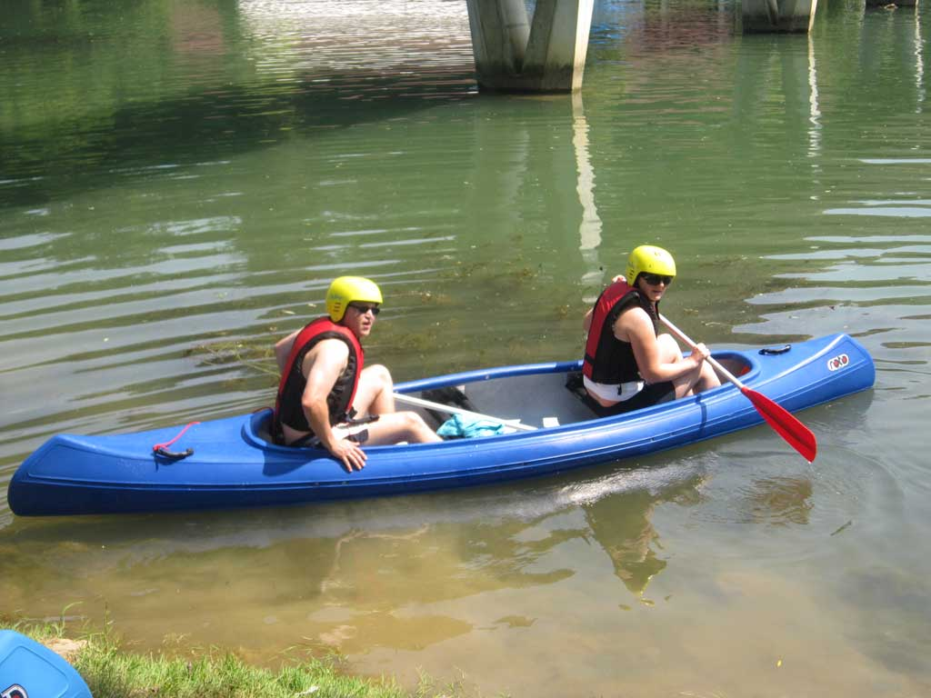
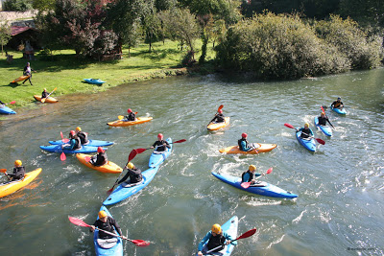
Slika Brežic, kje se vse to nahaja +

Slide 12

The price of three day posavje tour
Price includes: English speaking tour director, transportation, 3 nights accommodations, half board, entrance fees to Brežice castle, Kostanjevica Cave, Monasery, Spa Čatež and hire of boathing equipment. Price also includes English speaking guides and tour organization.
It is 350 euros per person.
Zvezda tourist agency wish you a lot of fun in pristine nature. Let‘s do it together!
Phone: +386 74992550
Telefaks: +386 74992550
E-mail: zvezda@ta.si
www.travelagencyzvezda.weebly.com

